Slide 1

IS362 – Fall 2020 – Final Project

Slide 2
IS362 – Final Project
For my final project, I have selected my data source from NYC Open Data. The Data Source I have selected is the NYC Water Consumption.
Data Source:
Water Consumption In The New York City
https://data.cityofnewyork.us/Environment/Water-Consumption-In-The-New-York-City/ia2d-e54m
Questions for the data set.
Water Consumption in Gallons
The overall population
Consumption per person grouped by population
Total consumption by GPP

Slide 3
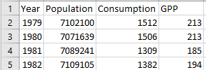
Data Source Analysis
Once the data source was downloaded and I did a visual inspection to determine whether or not the format was acceptable.

Slide 4
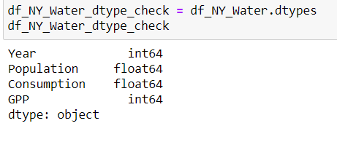
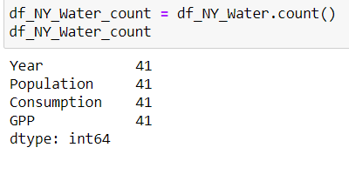
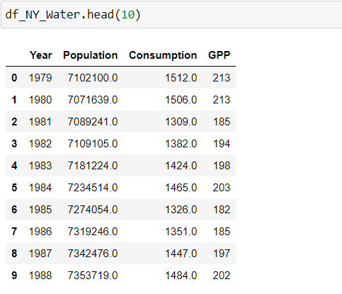
Data Source Validation
The data was ran into the Python Data Frame.
With data validation, I must check the data frame to ensure the datatype is correct and all rows have data to maintain consistency.
The head function was used to ensure data was read into data frame correctly.

Slide 5
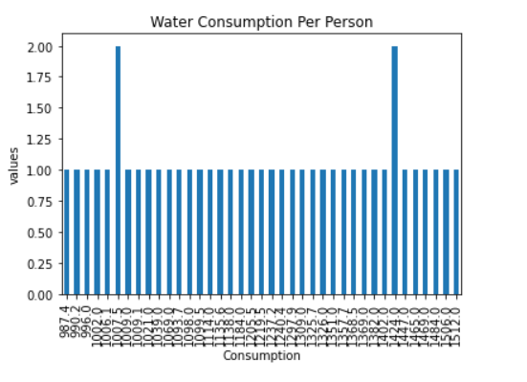
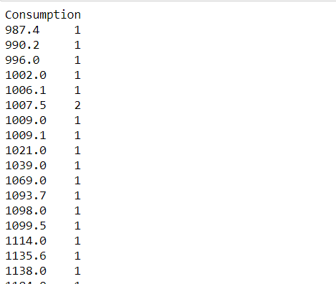
Total Consumption per person

Slide 6
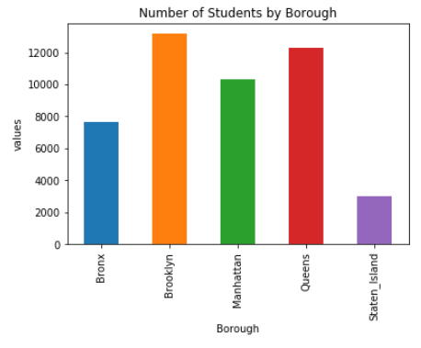
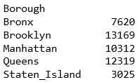
Number of students for each borough that participated in the SAT examination

Slide 7
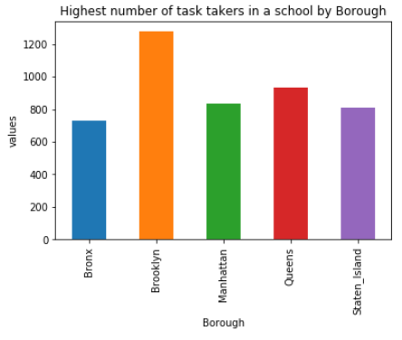
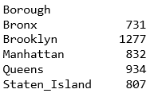
Highest number of test taker in a school for each Borough

Slide 8
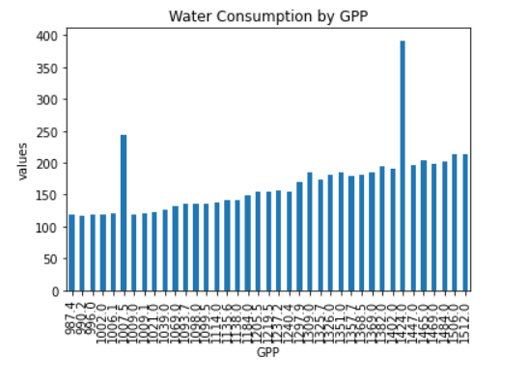
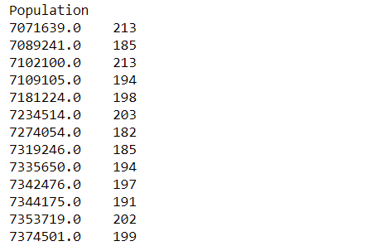
Water Consumption by GPP

Slide 9
Conclusion
Based on my analysis of the Water Consumption for NYC it can be concluded that as the Years went up the population increased and the consumption of water seemed to decrease. This may have been attributed through technology of efficiently transporting water to the the customers. This may also have been attributed to people to being at home as much, more individuals are working, going to college and school.

